Slide 1
Better Together: Text+Context
Resources Team
Rodolfo Zevallos, Ben Irving, John E. Ortega,
Sandeep Polisetty, and Hui Guan
Notes:
JOHN INTRODUCE

Slide 2

Reminder: What are We Doing?
Text (Titles, Abstracts, Body); Context (Citations)
Notes:
JOHN TALK

Slide 3
Two Approaches: Text vs Context
Text is based on abstracts and/or titles only (no citations)
Specter 1
Specter 2
Context is based on citations using a citation graph
Prone graph embeddings (node = paper, edge = citation)
Notes:
RODOLFO TALK

Slide 4
What to do with a new paper?
Notes:
We test the models by generalizing from new papers, which means obtaining embeddings for papers that have not been used in the training dataset.
To obtain the embedding for a new paper, we used the references of paper. Then, to determine if the new embedding represents the paper effectively, we used cosine similarity to search for similar papers.
In our experiments, we selected a new paper from ACL 2023 (with the following topics...) which has 40 references.
In this figure, you can see the flow of our experiment.
In the first experiment, we used all the references to create the new embedding. In the second experiment, we only used the references from the related works section, and in the third experiment, we utilized the longest cluster obtained from the reference clustering. The embeddings for the references were obtained from Specter 2 and Prone. To obtain the new embedding, we applied the centroid method to the embeddings. Finally, we compared the new embedding obtained from each experiment with a dataset of 500 papers related to the new paper's topics.
Testeamos los modelos mediante la generalización de nuevos papers, es decir: Como obtenemos los embeddings de los papers que no han sido utilizados en los datos de entrenamiento?
Para obtener el embedding del nuevo paper, lo hacemos a partir de las referencias del paper. Luego, para saber si el nuevo embedding representa al paper, usamos similitud de cosenos para buscar papers similares.
Para los experimentos utilizamos un paper nuevo de ACL 2023 (este paper tiene como temas….) el cual tiene 40 referencias.
En el primer experimentos utilizamos todas las referencias para crear el nuevo embedding, para el segundo solo las referencias de la seccion trabajos relacionados y para el tercero el grupo mas largo obtenido de la clusterizacion de las referencias. Los embeddings de las referencias son obtenidas de Specter 2 y Prone, Para obtener el nuevo embedding aplicamos el metodo centroid a las embeddings. Finalmente compararamos el nuevo embedding obtenido de cada experimento con un dataset de de 500 paper en temas relacionados al nuevo paper.

Slide 5
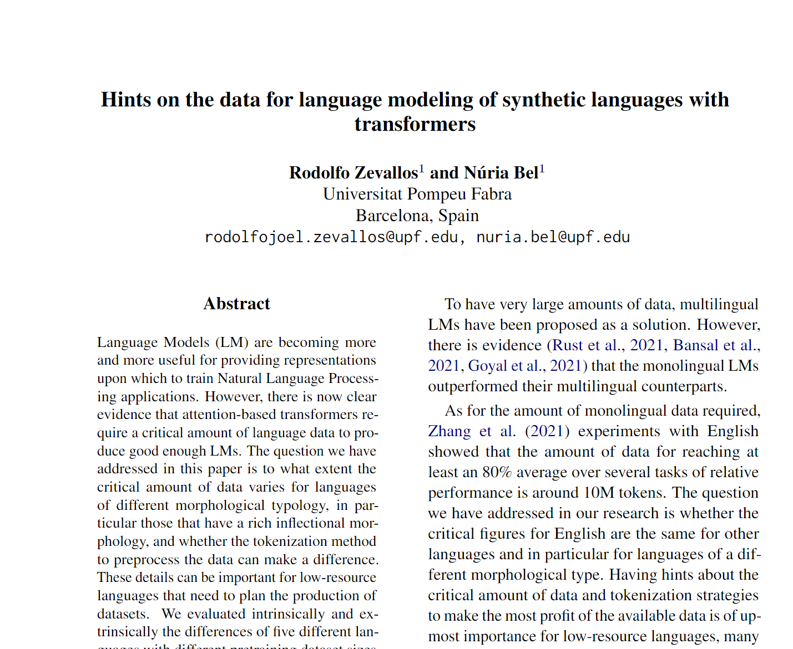
What to do with a new paper?
ACL 2023
Notes:
We test the models by generalizing from new papers, which means obtaining embeddings for papers that have not been used in the training dataset.
To obtain the embedding for a new paper, we used the references of paper. Then, to determine if the new embedding represents the paper effectively, we used cosine similarity to search for similar papers.
In our experiments, we selected a new paper from ACL 2023 (with the following topics...) which has 40 references.
In this figure, you can see the flow of our experiment.
In the first experiment, we used all the references to create the new embedding. In the second experiment, we only used the references from the related works section, and in the third experiment, we utilized the longest cluster obtained from the reference clustering. The embeddings for the references were obtained from Specter 2 and Prone. To obtain the new embedding, we applied the centroid method to the embeddings. Finally, we compared the new embedding obtained from each experiment with a dataset of 500 papers related to the new paper's topics.
Testeamos los modelos mediante la generalización de nuevos papers, es decir: Como obtenemos los embeddings de los papers que no han sido utilizados en los datos de entrenamiento?
Para obtener el embedding del nuevo paper, lo hacemos a partir de las referencias del paper. Luego, para saber si el nuevo embedding representa al paper, usamos similitud de cosenos para buscar papers similares.
Para los experimentos utilizamos un paper nuevo de ACL 2023 (este paper tiene como temas….) el cual tiene 40 referencias.
En el primer experimentos utilizamos todas las referencias para crear el nuevo embedding, para el segundo solo las referencias de la seccion trabajos relacionados y para el tercero el grupo mas largo obtenido de la clusterizacion de las referencias. Los embeddings de las referencias son obtenidas de Specter 2 y Prone, Para obtener el nuevo embedding aplicamos el metodo centroid a las embeddings. Finalmente compararamos el nuevo embedding obtenido de cada experimento con un dataset de de 500 paper en temas relacionados al nuevo paper.

Slide 6
What to do with a new paper?
ACL 2023
Task: find similar papers
Notes:
We test the models by generalizing from new papers, which means obtaining embeddings for papers that have not been used in the training dataset.
To obtain the embedding for a new paper, we used the references of paper. Then, to determine if the new embedding represents the paper effectively, we used cosine similarity to search for similar papers.
In our experiments, we selected a new paper from ACL 2023 (with the following topics...) which has 40 references.
In this figure, you can see the flow of our experiment.
In the first experiment, we used all the references to create the new embedding. In the second experiment, we only used the references from the related works section, and in the third experiment, we utilized the longest cluster obtained from the reference clustering. The embeddings for the references were obtained from Specter 2 and Prone. To obtain the new embedding, we applied the centroid method to the embeddings. Finally, we compared the new embedding obtained from each experiment with a dataset of 500 papers related to the new paper's topics.
Testeamos los modelos mediante la generalización de nuevos papers, es decir: Como obtenemos los embeddings de los papers que no han sido utilizados en los datos de entrenamiento?
Para obtener el embedding del nuevo paper, lo hacemos a partir de las referencias del paper. Luego, para saber si el nuevo embedding representa al paper, usamos similitud de cosenos para buscar papers similares.
Para los experimentos utilizamos un paper nuevo de ACL 2023 (este paper tiene como temas….) el cual tiene 40 referencias.
En el primer experimentos utilizamos todas las referencias para crear el nuevo embedding, para el segundo solo las referencias de la seccion trabajos relacionados y para el tercero el grupo mas largo obtenido de la clusterizacion de las referencias. Los embeddings de las referencias son obtenidas de Specter 2 y Prone, Para obtener el nuevo embedding aplicamos el metodo centroid a las embeddings. Finalmente compararamos el nuevo embedding obtenido de cada experimento con un dataset de de 500 paper en temas relacionados al nuevo paper.

Slide 7
What to do with a new paper?
ACL 2023
Task: find similar papers
Does the new paper have an ID to generate its vector in Specter 2 or Prone model?
Notes:
We test the models by generalizing from new papers, which means obtaining embeddings for papers that have not been used in the training dataset.
To obtain the embedding for a new paper, we used the references of paper. Then, to determine if the new embedding represents the paper effectively, we used cosine similarity to search for similar papers.
In our experiments, we selected a new paper from ACL 2023 (with the following topics...) which has 40 references.
In this figure, you can see the flow of our experiment.
In the first experiment, we used all the references to create the new embedding. In the second experiment, we only used the references from the related works section, and in the third experiment, we utilized the longest cluster obtained from the reference clustering. The embeddings for the references were obtained from Specter 2 and Prone. To obtain the new embedding, we applied the centroid method to the embeddings. Finally, we compared the new embedding obtained from each experiment with a dataset of 500 papers related to the new paper's topics.
Testeamos los modelos mediante la generalización de nuevos papers, es decir: Como obtenemos los embeddings de los papers que no han sido utilizados en los datos de entrenamiento?
Para obtener el embedding del nuevo paper, lo hacemos a partir de las referencias del paper. Luego, para saber si el nuevo embedding representa al paper, usamos similitud de cosenos para buscar papers similares.
Para los experimentos utilizamos un paper nuevo de ACL 2023 (este paper tiene como temas….) el cual tiene 40 referencias.
En el primer experimentos utilizamos todas las referencias para crear el nuevo embedding, para el segundo solo las referencias de la seccion trabajos relacionados y para el tercero el grupo mas largo obtenido de la clusterizacion de las referencias. Los embeddings de las referencias son obtenidas de Specter 2 y Prone, Para obtener el nuevo embedding aplicamos el metodo centroid a las embeddings. Finalmente compararamos el nuevo embedding obtenido de cada experimento con un dataset de de 500 paper en temas relacionados al nuevo paper.

Slide 8
What to do with a new paper?
ACL 2023
Task: find similar papers
Does the new paper have an ID to generate its vector in Specter 2 or Prone model?
NO
Notes:
We test the models by generalizing from new papers, which means obtaining embeddings for papers that have not been used in the training dataset.
To obtain the embedding for a new paper, we used the references of paper. Then, to determine if the new embedding represents the paper effectively, we used cosine similarity to search for similar papers.
In our experiments, we selected a new paper from ACL 2023 (with the following topics...) which has 40 references.
In this figure, you can see the flow of our experiment.
In the first experiment, we used all the references to create the new embedding. In the second experiment, we only used the references from the related works section, and in the third experiment, we utilized the longest cluster obtained from the reference clustering. The embeddings for the references were obtained from Specter 2 and Prone. To obtain the new embedding, we applied the centroid method to the embeddings. Finally, we compared the new embedding obtained from each experiment with a dataset of 500 papers related to the new paper's topics.
Testeamos los modelos mediante la generalización de nuevos papers, es decir: Como obtenemos los embeddings de los papers que no han sido utilizados en los datos de entrenamiento?
Para obtener el embedding del nuevo paper, lo hacemos a partir de las referencias del paper. Luego, para saber si el nuevo embedding representa al paper, usamos similitud de cosenos para buscar papers similares.
Para los experimentos utilizamos un paper nuevo de ACL 2023 (este paper tiene como temas….) el cual tiene 40 referencias.
En el primer experimentos utilizamos todas las referencias para crear el nuevo embedding, para el segundo solo las referencias de la seccion trabajos relacionados y para el tercero el grupo mas largo obtenido de la clusterizacion de las referencias. Los embeddings de las referencias son obtenidas de Specter 2 y Prone, Para obtener el nuevo embedding aplicamos el metodo centroid a las embeddings. Finalmente compararamos el nuevo embedding obtenido de cada experimento con un dataset de de 500 paper en temas relacionados al nuevo paper.

Slide 9
What to do with a new paper?
ACL 2023
Task: find similar papers
Does the new paper have an ID to generate its vector in Specter 2 or Prone model?
NO
How to create the vector of my new paper?
Notes:
We test the models by generalizing from new papers, which means obtaining embeddings for papers that have not been used in the training dataset.
To obtain the embedding for a new paper, we used the references of paper. Then, to determine if the new embedding represents the paper effectively, we used cosine similarity to search for similar papers.
In our experiments, we selected a new paper from ACL 2023 (with the following topics...) which has 40 references.
In this figure, you can see the flow of our experiment.
In the first experiment, we used all the references to create the new embedding. In the second experiment, we only used the references from the related works section, and in the third experiment, we utilized the longest cluster obtained from the reference clustering. The embeddings for the references were obtained from Specter 2 and Prone. To obtain the new embedding, we applied the centroid method to the embeddings. Finally, we compared the new embedding obtained from each experiment with a dataset of 500 papers related to the new paper's topics.
Testeamos los modelos mediante la generalización de nuevos papers, es decir: Como obtenemos los embeddings de los papers que no han sido utilizados en los datos de entrenamiento?
Para obtener el embedding del nuevo paper, lo hacemos a partir de las referencias del paper. Luego, para saber si el nuevo embedding representa al paper, usamos similitud de cosenos para buscar papers similares.
Para los experimentos utilizamos un paper nuevo de ACL 2023 (este paper tiene como temas….) el cual tiene 40 referencias.
En el primer experimentos utilizamos todas las referencias para crear el nuevo embedding, para el segundo solo las referencias de la seccion trabajos relacionados y para el tercero el grupo mas largo obtenido de la clusterizacion de las referencias. Los embeddings de las referencias son obtenidas de Specter 2 y Prone, Para obtener el nuevo embedding aplicamos el metodo centroid a las embeddings. Finalmente compararamos el nuevo embedding obtenido de cada experimento con un dataset de de 500 paper en temas relacionados al nuevo paper.

Slide 10
Our solution: new vector from the paper references.
New Paper
Get Vectors
(Specter 2 or Prone)
Vectors
New
Vector
Centroid Method
Notes:
Get paper references
To obtain the embeddings of each reference using Specter 2 or Prone
Applying centroid method to the references to get a new embedding

Slide 11
Our solution: new vector from the paper references.
Now! We can find similar papers
New Paper
Get Vectors
(Specter 2 or Prone)
Vectors
New
Vector
Centroid Method
Notes:
Get paper references
To obtain the embeddings of each reference using Specter 2 or Prone
Applying centroid method to the references to get a new embedding

Slide 12
Our solution: new vector from the paper references.
Now! We can find similar papers
New
Vector
New Paper
Get Vectors
(Specter 2 or Prone)
INPUT
Vectors
Nearest Neighbors
OUTPUT
New
Vector
Centroid Method
Recommendations
Notes:
Get paper references
To obtain the embeddings of each reference using Specter 2 or Prone
Applying centroid method to the references to get a new embedding

Slide 13
Using all reference citations Cosine
Prone
Impact of Tokenization on Language Models: An Analysis for Turkish
Cross-Lingual Named Entity Recognition Using Parallel Corpus: A New Approach Using XLM-RoBERTa Alignment
Specter 2
oLMpics-On What Language Model Pre-training Captures
Fast, Effective, and Self-Supervised: Transforming Masked Language Models into Universal Lexical and Sentence Encoders
97%
95%
96%
95%
I believe that Prone results are closer to my paper.

Slide 14
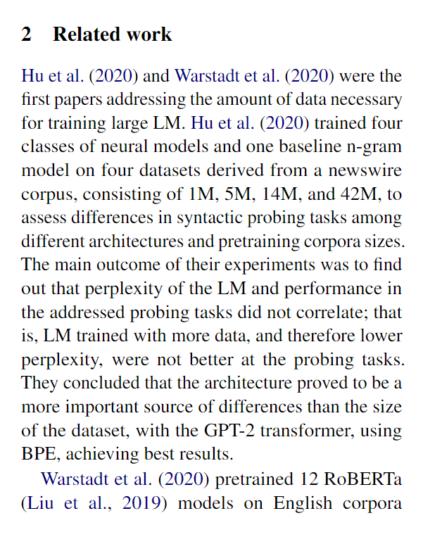
Related Work Hypothesis
Related work references seem to be a better representation.

Slide 15
Using only related work ref. citations Cosine
Prone
Impact of Tokenization on Language Models: An Analysis for Turkish
RobeCzech: Czech RoBERTa, a monolingual contextualized language representation model
Specter 2
oLMpics-On What Language Model Pre-training Captures
Fast, Effective, and Self-Supervised: Transforming Masked Language Models into Universal Lexical and Sentence Encoders
99%
95%
97%
95%
I believe that Prone results are closer to my paper.

Slide 16
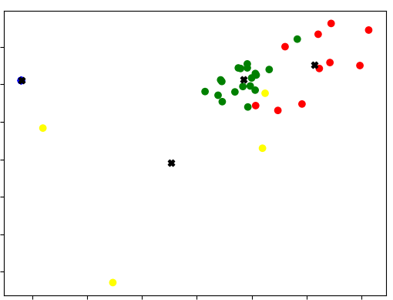
Related Work Neighborhood Experiment
Green dots represent Related Work reference citations
Notes:
We cluster our references, but (question)
Take the green references because we believe they are almost the same as those of the related work.
we take the longest and most compact group
And they are the most closely related to each other and with the paper.

Slide 17
Using all ref citations with clustering Cosine
Prone
Phonologically Informed Edit Distance Algorithms for Word Alignment with Low-Resource Languages
A Basic Language Technology Toolkit for Quechua
Specter 2
On the Stability of Fine-tuning BERT: Misconceptions, Explanations, and Strong Baselines
Probing Across Time: What Does RoBERTa Know and When?
92%
90%
92%
91%
I believe that Prone results are closer to my paper.

Slide 18
Following the Hunch
Experimentation with bigger data (~ 300 million papers).
Explain reference citations neighborhoods.
Related Work prediction.
Evaluation
Workshop timeline to be met!
Notes:
JOHN

Slide 19
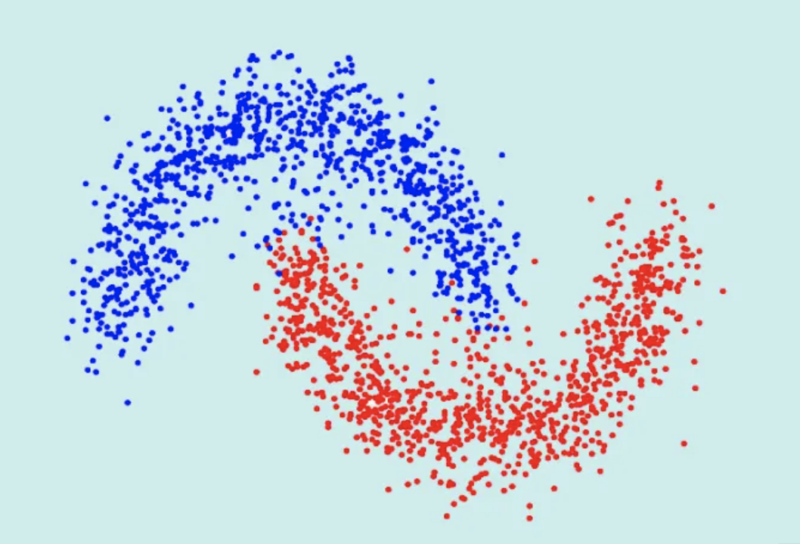
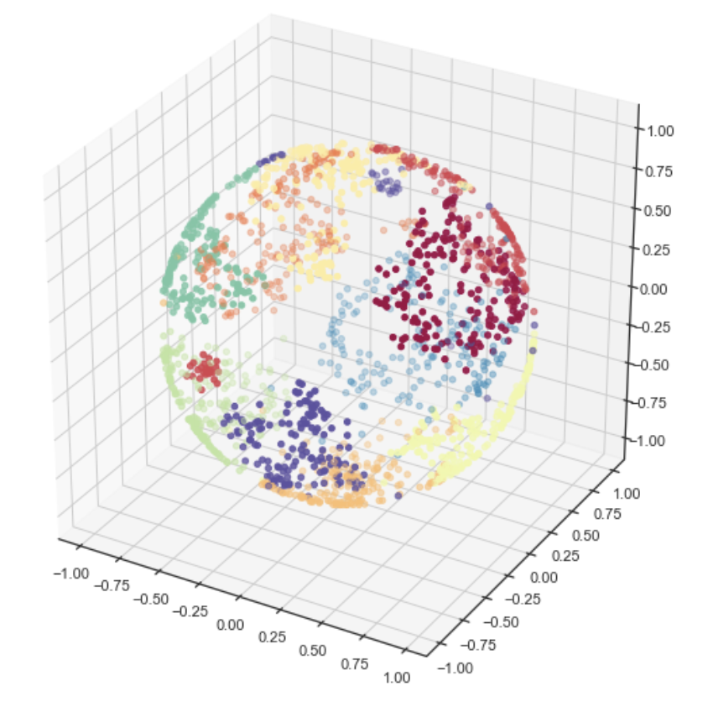
Find these relationships at scale
ProNE
x 14
Spectral Clustering
tSVD
SVD
K
N
Embeddings
Notes:
Images courtesy of:
https://datascientest.com/spectral-clustering

Slide 20
Model and limitations
Limited space (<= 2 TB per job)
Limited time (<= 1 day per job)
Without dividing code: 2 TB of memory, 3.8 days
Prone.py
Notes:
Ben Talk
Without dividing up file: computation on full graph partition will take 9.8 TB of memory, and will run over 92.2 hours (3.8 days)

Slide 21
Model and limitations
Limited space (<= 2 TB per job)
Limited time (<= 1 day per job)
Without dividing code: 2 TB of memory, 3.8 days
Prefactor
Prone.py
Chebyshev
Finish step

Slide 22
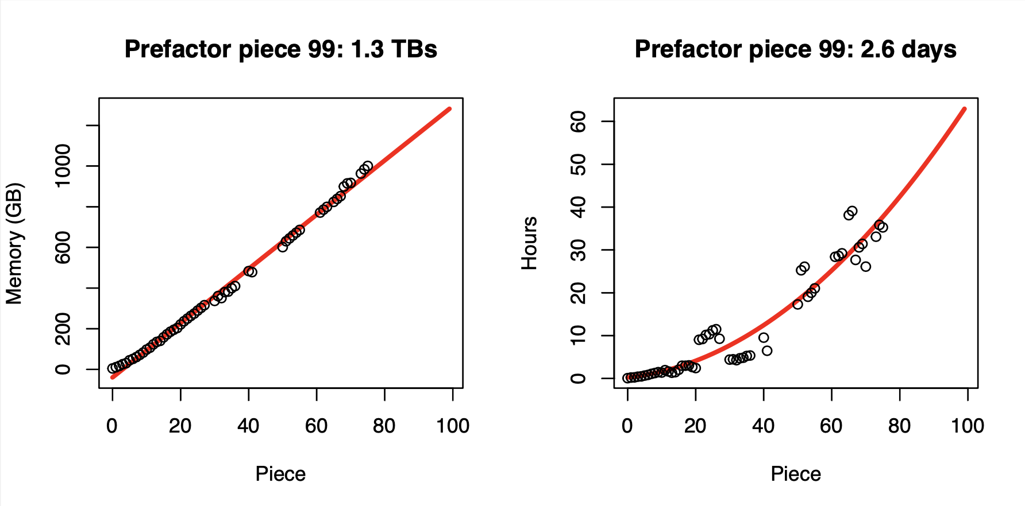
Prefactor Step
We are all not equal under the time constraint laws…
Graph Partition
Graph Partition

Slide 23
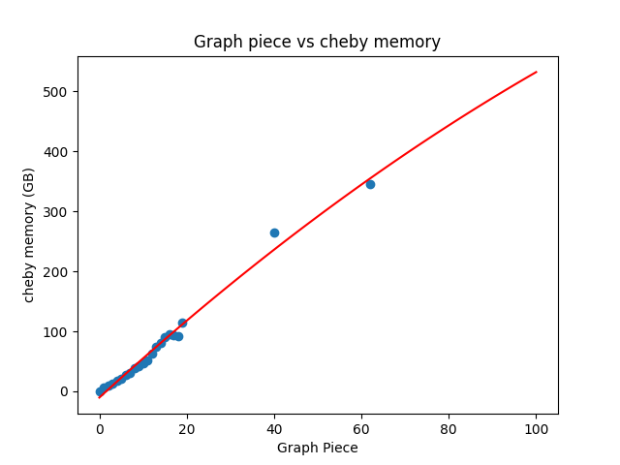
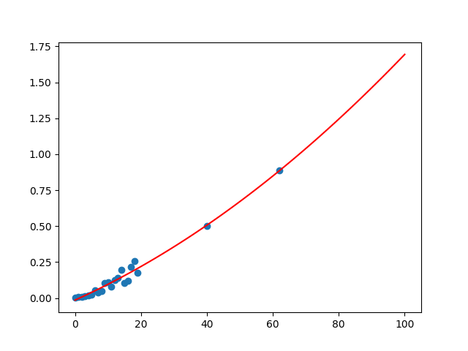
Chebyshev step (1 iteration) - what I CAN run
Memory vs Graph Part - 532GB
Time vs Graph Part 1.69 hours
Time (H)
Memory (GB)
Graph Partition
Graph Partition
Notes:
Chebyshev memory utilization: 1 iterations, will take 532 GB of memory
Piece
Full graph time projection: 1.69 Hours per step (1 hr 41 minutes)

Slide 24
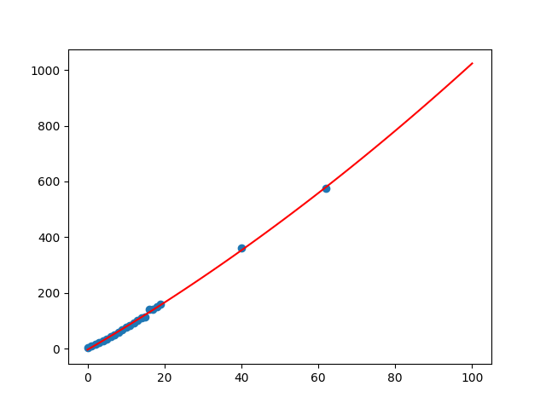
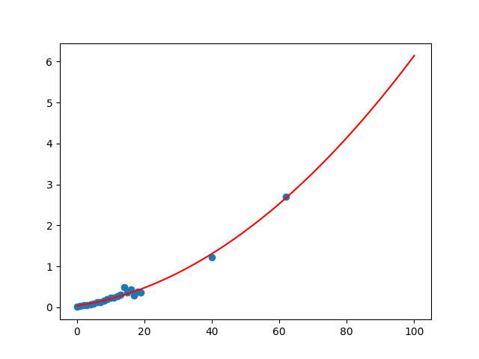
Finish step - what I CAN run, within constraints
Graph Part vs Memory - 1TB
Graph Part vs Time - 6.14 Hrs
Memory (GB)
Time (H)
Graph Partition
Graph Partition
Notes:
Finish memory utilization for full graph: 1 TB (or thereabouts)
Finish time to run: 6.14 hours

Slide 25
To parallelize, or not to parallelize
GPUs are faster (even for SVD)
And, torch.sparse (cuSparse) is good (for the chebyshev iterations)
BUT

Slide 26
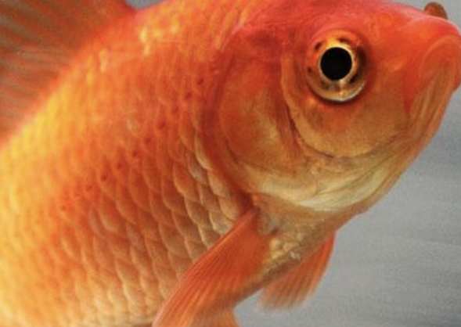
To parallelize, or not to parallelize
GPUs are faster (even for SVD)
And, torch.sparse (cuSparse) is good (for the chebyshev iterations)
BUT
GPU memory
The importance of parallelization falters…
(At least at Northeastern)
Notes:
On v100 with 1% of graph:
We shave 10% of time on the chebyshev matrix multiplications (negligible gains)
speedups would scale quickly with the matrix size

Slide 27
Next Steps
Optimize further (cython, more pytorch, and dax)
Resolve hunches, combine work.
Build a useable system.
Notes:
Ben Talk

Slide 28
Research Question:
What is the best approach to combine text and context?

Slide 29
Novelties
Insights tailored to Semantic Scholar citation graph
Large scale: 200M vs. 3M nodes
Data shift: Year 1779 - 2023
New approaches for scalable and efficient GNN training

Slide 30
Q1: How to combine text and context?
Shallow Encoding
DeepWalk
Node2vec
ProNE
Deep Encoding
GNN

Slide 31
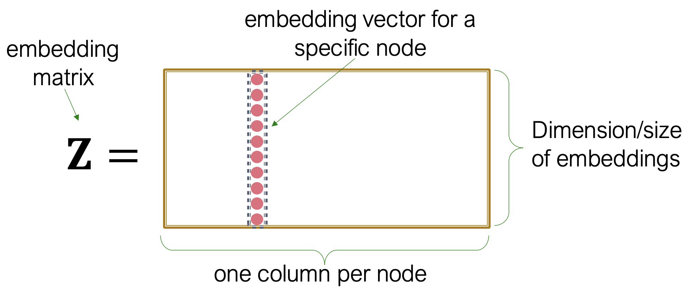
Approach #1: Shallow Encoding
Encoder is just an embedding lookup

Slide 32
Approach #1: Shallow Encoding
Citation Graph
Encoder is just an embedding lookup
ProNE Encoder
Node Embedding (Context)

Slide 33
How to use the node embedding from ProNE?
Node Embedding
of node i
Text Feature
of node i
…
Concat
Combined Feature
of node i
Combined Feature
of node j
MLP
Score (i, j)

Slide 34
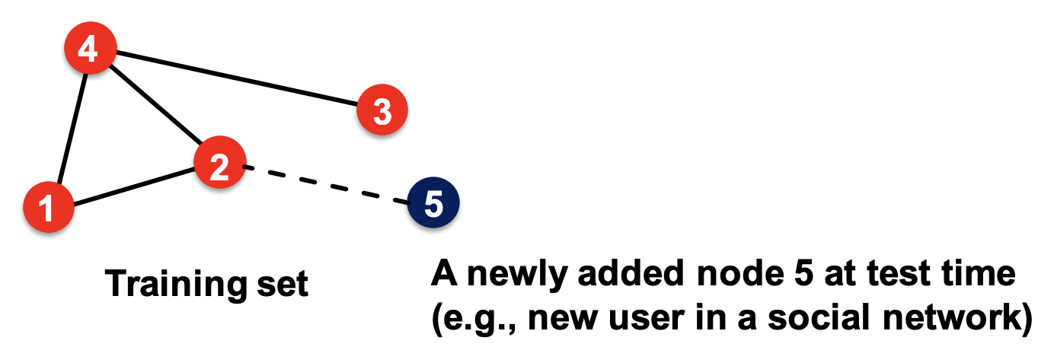
Limitation of approach #1: the transductive Issue
Updated citation Graph
a new paper added as node 5
ProNE Encoder
Need to re-train (which is expensive) or approximate ProNE!
Updated node embedding

Slide 35
Limitation of approach #1: the transductive Issue
Node embedding
of node 5
Text Feature
of node 5
Updated citation Graph
Concat
…
a new paper added as node 5
ProNE Encoder
Combined Feature
of node 5
Combined Feature
of node 1-4
Need to re-train ProNE, which is expensive!
Or approximate
Updated node embedding
MLP
Embedding Lookup
Score (i, j)

Slide 36
Limitation of approach #1: the transductive Issue
Node embedding
of node 5
Text Feature
of node 5
Updated citation Graph
Concat
…
Speed bottleneck
a new paper added as node 5
ProNE Encoder
Combined Feature
of node 5
Combined Feature
of node 1-4
Need to re-train ProNE, which is expensive!
Or approximate
Updated node embedding
MLP
Embedding Lookup
Score (i, j)

Slide 37
Approach #2: Deep Encoding
Encoder is GNN
Citation Graph
Node Features (Text)
GNN Encoder
Combined Features (Context + Text)

Slide 38
How to use the GNN on a new paper?
Induced graph
of node 5
Node features of the induced graph
a new paper added as node 5
GNN Encoder
Small updates can be handled by inference only.
No training needed.

Slide 39
How to use the GNN on a new paper?
Induced graph
of node 5
Node features of the induced graph
a new paper added as node 5
GNN Encoder
Small updates can be handled by inference only.
No training needed.
Combined Feature of node 5
Combined features for nodes 1-4
MLP
Score (i, j)

Slide 40
How to use the GNN on a new paper?
Induced graph
of node 5
Node features of the induced graph
Inference only; faster
a new paper added as node 5
GNN Encoder
Small updates can be handled by inference only.
No training needed.
Combined Feature of node 5
Combined features for nodes 1-4
MLP
Score (i, j)

Slide 41
Q2: What does “best” mean?
Accuracy: predict missing citations of a paper?
Scalability: the training costs when generalizing to large graphs?
Generalize to new papers: predict citations of papers that are not in the training dataset ?
Notes:
Accuracy being evaluated by other teams. What is the cost of generalizability

Slide 42
Benchmarking Link Prediction Methods
Approaches
Shallow Encoder: ProNE [AAAI’19]
Deep Encoder: GraphSAGE [NeurIPS’17]
Benchmarks
OGB: Citation Graph
Semantic scholar citation graph (ongoing)
Metrics
Accuracy
Training time
Reference:
Zhang, Jie, et al. "Prone: Fast and scalable network representation learning." IJCAI. Vol. 19. 2019.
Hamilton, Will, Zhitao Ying, and Jure Leskovec. "Inductive representation learning on large graphs." Advances in neural information processing systems 30 (2017).
Notes:
The evaluation metric is Mean Reciprocal Rank (MRR), where the reciprocal rank of the true reference among the negative candidates is calculated for each source paper, and then the average is taken over all source papers.

Slide 43
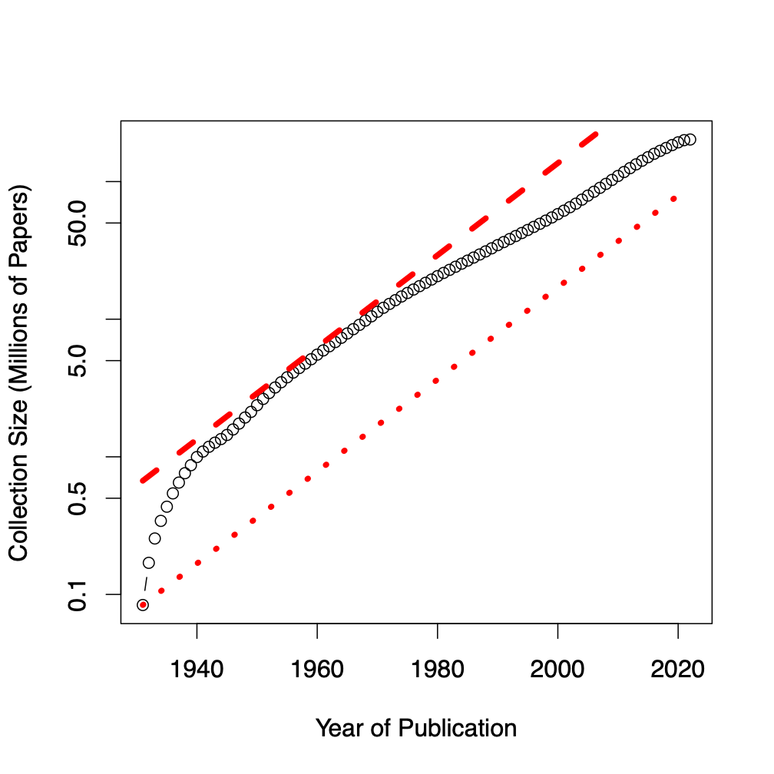
Benchmarks
Dataset | #N | #E | Node Raw Features
ogbl-citation2 | 3M | 31M | 128 (eg. word2vec)
Semantic scholar | 200M | 2B | 768 (eg. Bert)
Notes:
Graph showing growth

Slide 44
Preliminary Results
Datset | Model | Training Time | Test Accuracy
Citation-2 | GraphSAGE | 550 sec | 0.74
Citation-2 | Prone + MLP | 800 sec | 0.65
Citation-2 | SEAL | >1 hour | 0.65
SEMANTIC SCHOLAR ??
Notes:
Spreadsheet of the results: https://docs.google.com/spreadsheets/d/1NAd5RveFklsbkEc4BlfcpBBxk9PNrn67WFbSja6LYlM/edit?usp=sharing

Slide 45
Future Work: Scalability
Compare GNN vs ProNE on the original semantic scholar graph
Speed up state-of-the-art GNN approaches
Graph | Nodes | Edges | Feature Size
Citation2 | 2.9M | 30.38M | 1.45 GB
Semantic-010 | 8M | 100M | 24 GB
Semantic-055 | 57M | 1561M | 171 GB
Semantic-Full | 270M | 2151M | 600 GB

Slide 46
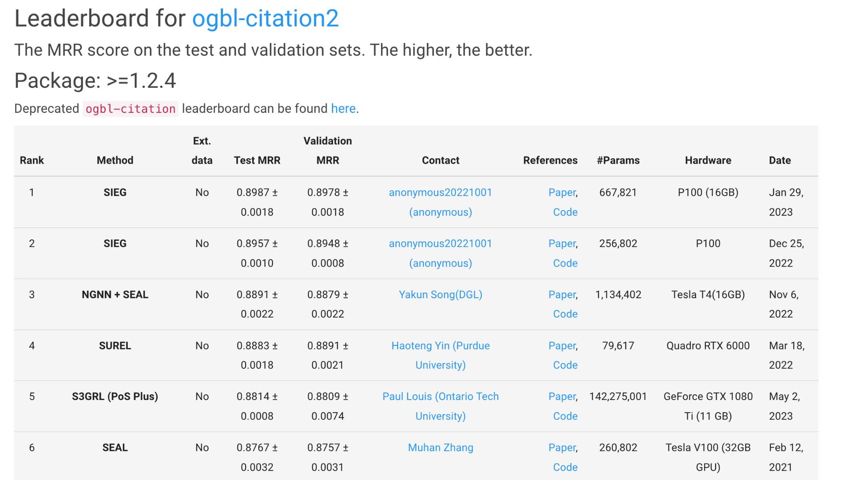
Approach we use
Notes:
Todo: Add conclusion side.

Slide 47
Takeaways:
Replicated models being targeted on the standard open graph benchmark.
Next Step: Scale these models for the 100x bigger semantic scholar graph.

Slide 48
BACKUP

Slide 49
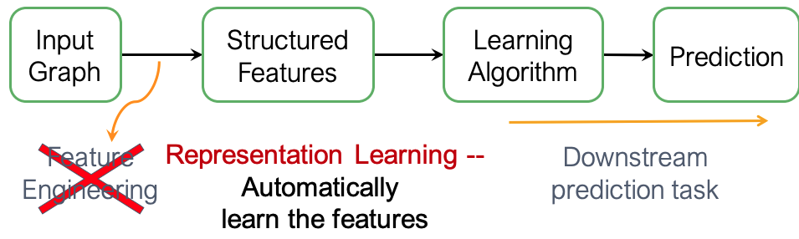
Q1: How to combine text and context?
Shallow Encoding
DeepWalk
Node2vec
ProNE
Deep Encoding
GNN

Slide 50
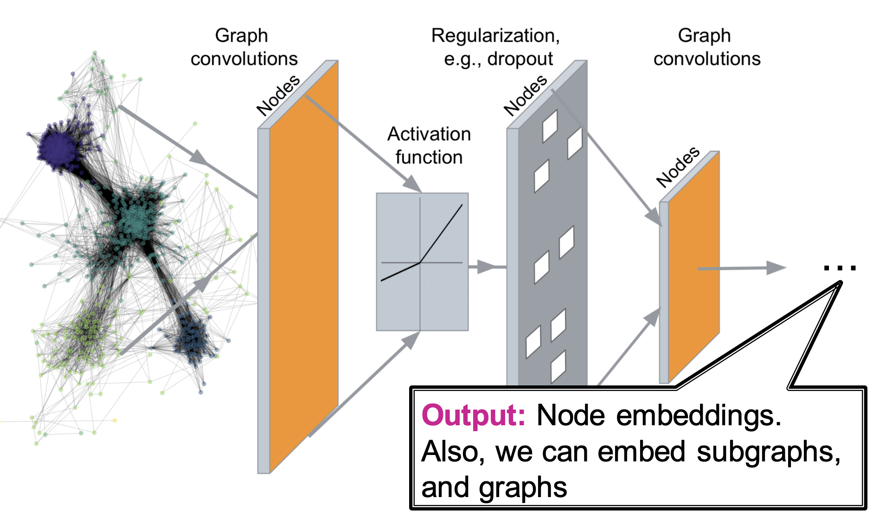
Approach #2: Deep Encoding
Encoder is GNN
Citation Graph
Node Features (Text)
GNN Encoder
Combined Features (Context + Text)

Slide 51
Prediction Task and Evaluation Metrics
Predict missing citations given existing citations of a paper
Two of a paper’s references are randomly dropped
The model need to rank the missing two references higher than 1K negative reference candidates
Negative references are randomly sampled from all previous papers that are not referenced
Evaluation metric: MRR

Slide 52
References
Link prediction: analysis of complex interconnected data: http://www.reirab.com/Teaching/NS20/9_LinkPrediction.pdf
OGB Link property prediction benchmark: https://ogb.stanford.edu/docs/linkprop/
Node embedding Lecture 3: http://web.stanford.edu/class/cs224w/slides/03-nodeemb.pdf
GNN lecture 4:
http://web.stanford.edu/class/cs224w/slides/04-GNN1.pdf

